Slide 1
Lab 1: Verilog and FPGA Refresher
Dr. Mostafa Gouneem
Fall 2022

Slide 2
Agenda
Objectives
Introduction
Experiment 1: A simple inverter
Experiment 2: A 4-digit 7-segment display driver
Experiment 3: A 4-digit 7-segment display driver with optimized Divisor
Deliverables

Slide 3
Objectives
The objective of this lab is to review some Verilog and FPGA basics and to familiarize you with Vivado Design Suite and the Nexys A7 Trainer Board

Slide 4
Introduction
Verilog is a hardware description language used to model digital circuits.
Digital circuits described by Verilog are typically simulated and then implemented either on an FPGA or as an ASIC.
In this lab we are going to review Verilog through modeling a set of simple circuits and implementing them on the Nexys A7 board.
The Nexys A7 is manufactured by Digilent and is based on Xilinx Artix-7 FPGA.
The Nexys A7 can be programmed via the Vivado Design Suite which is a full featured software suite designed by Xilinx too.
Vivado is the successor of Xilinx ISE and it encapsulates many features including a simulator, a synthesizer, bitstream generator, and an FPGA programmer.

Slide 5
Introduction
Company | FPGA | Tools
Xilinx | Spartan Virtex Artix Kintex Zynq | Vivado
Intel | MAX Cyclone Arria Stratix Agilex | Quartus
Microsemi | ProASIC IGLOO SmartFusion | Libero SoC
Lattice | LatticeXP2 LatticeECP2/M ECP5 / ECP5-5G CertusPro-NX | Diamond

Slide 6
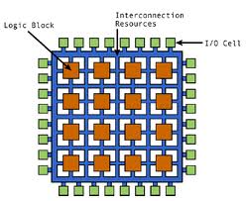
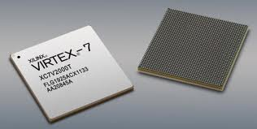
FPGA Design Flow
RTL
VHDL/Verilog
Verify
Function
Synthesis
Gate-Level
Netlist
Verify
Function & Timing
Physical
Layout
Place/Route
Verify
Timing
FPGA Configuration File

Slide 7
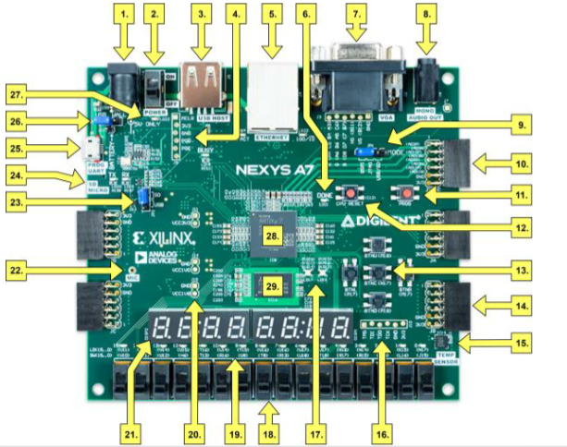
Introduction
No. | Component Description | No. | Component Description
1 | Power jack | 2 | Power switch
3 | USB host connector | 4 | PIC24 programming port (factory use)
5 | Ethernet connector | 6 | FPGA programming done LED
7 | VGA connector | 8 | Audio connector
9 | Programming mode jumper | 10 | Analog signal Pmod port (XADC)
11 | FPGA configuration reset button | 12 | CPU reset button (for soft cores)
13 | Five pushbuttons | 14 | Pmod port(s)
15 | Temperature sensor | 16 | JTAG port for (optional) external cable

Slide 8
Introduction
No. | Component Description | No. | Component Description
17 | Tri-color (RGB) LEDs | 18 | Slide switches (16)
19 | LEDs (16) | 20 | Power supply test point(s)
21 | Eight digit 7-seg display | 22 | Microphone
23 | External configuration jumper (SD / USB) | 24 | MicroSD card slot
25 | Shared UART/ JTAG USB port | 26 | Power select jumper and battery header
27 | Power-good LED | 28 | Xilinx Artix-7 FPGA
29 | DDR2 memory

Slide 9
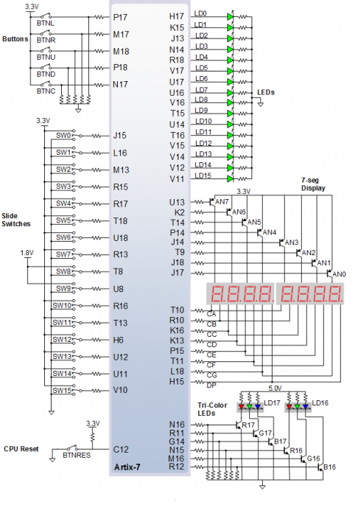
Introduction

Slide 10
Experiment 1: A simple inverter
Create a new RTL project targeting the Nexys A7 100T board using Vivado.
Make sure that you select the right target board when you create the project.
If Nexys A7 is not available, it should be installed before proceeding any further Add that we should choose Nexys A7 100T not 50T
Add a new Verilog module representing a simple inverter. The module should have a 1-bit input port named A and a 1-bit output port named B
Filename: inverter.v and module name should be inverter
Simulate the testbench

Slide 11
Experiment 1: A simple inverter
Create a constraint file attaching input port A to switch 0 (pin J15) and output port B to LED 0 (pin H17).
The constraint file should contain the following 4 lines:
set_property package_pin J15 [get_ports A]
set_property iostandard LVCMOS33 [get_ports A]
set_property package_pin H17 [get_ports B]
set_property iostandard LVCMOS33 [get_ports B]
Note: please use the same spacing as above. For example, you must leave a space after get_ports
Note: instead of writing the constraints by yourself, you can use the GUI to assign pins in the IO pin Planning Layout, check Vivado Tutorial for the details.

Slide 12
Experiment 1: A simple inverter
Synthesize, implement, and generate a bit stream for your design.
Use the generated bitstream to program the Nexys A7 board and check that the board behaves as expected. Make sure to connect the board to your computer, to power it on, and to adjust the programming jumper to JTAG before this step.

Slide 13
Experiment 2: A 4-digit 7-segment display driver
Create a new RTL project targeting the Nexys A7 board using Vivado
Design and implement a 4-digit 7-segment display driver module controlled by the 13 input switches. The Nexys A7 has 16 switches, but we choose to use only 13 switches to specify the binary value we want to visualize on the 7-segment display. Why?
File name: Four_Digit_Seven_Segment_Driver.v, top level module name: Four_Digit_Seven_Segment_Driver
The Nexys A7 board contains two four-digit common anode seven-segment LED displays, configured to behave like a single eight-digit display
All 7 segments of a digit have a common anode and each segment has individual cathode

Slide 14
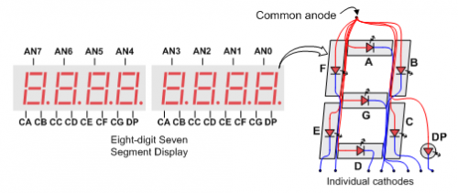
Experiment 2: A 4-digit 7-segment display driver
All 4 digits share the same cathode pins
So a trick is needed to display 4 different numbers on the 4-digit seven-segment LED display

Slide 15
Experiment 2: A 4-digit 7-segment display driver
The idea is to repeatedly activate one digit at a time in a rotational pattern.
So we would activate digit1, then digit2, then digit3, then digit4, then digit1 again, and so on.
This of course would make each digit flicker quickly, but if it is refreshed quick enough (at a rate between 60 Hz, and 1 KHz), the human eye will not be able to notice that flickering
In order to do so, we make use of the built-in 100 MHz clock available on pin E3 of the Nexys A7 package whose frequency we divide by 2²⁰ using a 20-bit counter.
The result will be a clock of 95.37 Hz (a period of 10.49 ms).
We can further split this period into 4 equal time slots of 2.6 ms each such that each digit is activated for 2.6 ms every 10.49 ms

Slide 16
Experiment 2: A 4-digit 7-segment display driver
In order to do this final splitting we consider the most significant 2 bits of the 20 bit counter and change the active digit as soon as they change
module Four_Digit_Seven_Segment_Driver (
input clk,
input [12:0] num,
output reg [3:0] Anode,
output reg [6:0] LED_out
);
reg [3:0] LED_BCD;
reg [19:0] refresh_counter = 0; // 20-bit counter
wire [1:0] LED_activating_counter;
always @(posedge clk)
begin
refresh_counter <= refresh_counter + 1;
end
assign LED_activating_counter = refresh_counter[19:18];

Slide 17
Experiment 2: A 4-digit 7-segment display driver
always @(*)
begin
case(LED_activating_counter)
2'b00: begin
Anode = 4'b0111;
LED_BCD = num/1000;
end
2'b01: begin
Anode = 4'b1011;
LED_BCD = (num % 1000)/100;
end
2'b10: begin
Anode = 4'b1101;
LED_BCD = ((num % 1000)%100)/10;
end
2'b11: begin
Anode = 4'b1110;
LED_BCD = ((num % 1000)%100)%10;
end
endcase
end

Slide 18
Experiment 2: A 4-digit 7-segment display driver
always @(*)
begin
case(LED_BCD)
4'b0000: LED_out = 7'b0000001; // "0"
4'b0001: LED_out = 7'b1001111; // "1"
4'b0010: LED_out = 7'b0010010; // "2"
4'b0011: LED_out = 7'b0000110; // "3"
4'b0100: LED_out = 7'b1001100; // "4"
4'b0101: LED_out = 7'b0100100; // "5"
4'b0110: LED_out = 7'b0100000; // "6"
4'b0111: LED_out = 7'b0001111; // "7"
4'b1000: LED_out = 7'b0000000; // "8"
4'b1001: LED_out = 7'b0000100; // "9"
default: LED_out = 7'b0000001; // "0"
endcase
end
endmodule

Slide 19
Experiment 2: A 4-digit 7-segment display driver
Create a constraint file attaching:
The inputs of the module to switches 0 to 12
The outputs of the module to the cathodes and anodes of the 7-segment LEDs
The 100 MHz clock input to pin E3
File name: FDSSD_constraint.xdc
Program the Nexys A7 board and test it
Record the utilization (number of LUTs, FFs, and IO ports) consumed by the driver circuit you designed. You can find this information after you have completed the implementation step in the utilization report

Slide 20
Experiment 3: A 4-digit 7-segment display driver with optimized Divisor
Note: Make a New project, don’t override Exp 2 files.
Repeat Experiment 2 but change the division and remainder methods to an optimized algorithm
File name: Four_Digit_Seven_Segment_Driver_Optimized.v, top level module name: Four_Digit_Seven_Segment_Driver_Optimized
The division (/) and remainder (%) operators are very expensive. Some tools are not even able to synthesize them (that is not the case with Vivado)
Here is a more efficient design to convert binary to BCD (called Shift and Add-3 Algorithm).
https://pubweb.eng.utah.edu/~nmcdonal/Tutorials/BCDTutorial/BCDConversion.html

Slide 21
Experiment 3: A 4-digit 7-segment display driver with optimized Divisor
Shift and Add-3 Algorithm
module BCD (
input [7:0] num,
output reg [3:0] Hundreds,
output reg [3:0] Tens,
output reg [3:0] Ones
);
integer i;
always @(num)
begin
//initialization
Hundreds = 4'd0;
Tens = 4'd0;
Ones = 4'd0;
for (i = 7; i >= 0 ; i = i-1 )
begin
if(Hundreds >= 5 )
Hundreds = Hundreds + 3;
if (Tens >= 5 )
Tens = Tens + 3;
if (Ones >= 5)
Ones = Ones +3;

Slide 22
Experiment 3: A 4-digit 7-segment display driver with optimized Divisor
Shift and Add-3 Algorithm
You will need to modify the algorithm to handle thousands as well.
//shift left one
Hundreds = Hundreds << 1;
Hundreds [0] = Tens [3];
Tens = Tens << 1;
Tens [0] = Ones[3];
Ones = Ones << 1;
Ones[0] = num[i];
end
end
endmodule

Slide 23
Deliverables
Each student is required to submit an individual report.
For Verilog descriptions or constraint files, please attach the .v and .xdc files (not the whole project) or copy and paste the code. No photos or screenshots accepted.
The submission should be a zipped folder with the following Structure
YourID_Report.pdf
Exp1 : Folder containing your codes for experiment#1
Exp2 : Folder containing your codes for experiment#2
Exp3 : Folder containing your codes for experiment#3
Submission deadline: Monday September 12th, 11:59 pm.
Submission method: On Blackboard

Slide 24
Deliverables
Report of Lab1 should include:
[0 pts] Your names, student IDs, Team Name
[2 pts] A technical summary of experiments conducted in the lab (Steps, Results, components (a screen shot with Schematic design might help), code functionality, etc...]
[4 pts] Any Verilog descriptions or constraint files you wrote for the lab
[2 pts] Compare the utilization and delay of experiment 2 vs experiment 3, please add your comments about the results
[2 pts] Results recorded in the last step of experiment 2 & 3 (Photos or screen shots)

